Slide 1
ADVANCED HEALTHCARE PLATFORM – AHP To improve decision making, cut costs and identify new business opportunities
Advanced Analytics Service[AAS]: Single platform to support the entire data analytics process.
Platform to predict outcomes, identify untapped opportunities.
Expose hidden risks.
Anticipate the future, and act in the moment.
Decision making opportunity beyond reporting.
Join data from multiple sources without another tool Terabyte and petabyte-scale support
Advanced Claim Adjudication Service[ACAS]: Distributed claim adjudication using MongoDB/Hibernate Object Grid Model(OGM)
All you know
Self Service Business Intelligence UI – MetaBase Integration
Code-free analytics environment

Slide 2
Unified Component Architecture
Hortonworks/Cloud break/AWS EMR/Cloudera/MapR
MongoDB, (HDFS, Hive Dependency)
Tensor flow/Deeplearning4j
Technical Components
Apache Kafka, Spark Streaming in YARN
Apache Spark (SQL, MLIB, GRAPHX) in YARN
Spring Boot, Apache Livy
MetaBase, Slack
ADVANCED HEALTHCARE PLATFORM - AHP
Advanced Analytics Service
Cluster Infrastructure
Prescriptive
Datalake Management - Claims
Image And Clinical Data Processing
Descriptive
Graph
Data Ingestion And Streaming – DATA PROCESSOR
Business Analytics
Data And Graph Processing – DATA PROCESSOR
Predictive
Job Scheduling, Monitoring, EAI – DATA ORCHESTRATOR
Data Discovery – Self Service Business Intelligence UI, Collaboration
Functional Components
Image/Voice/Text Processing
HL7 Processing
Clinical
Analytics
Advanced Claim Adjudication Service
Pre-Adjudication
Adjudication
Post Processing
Claim
Adjudication

Slide 3
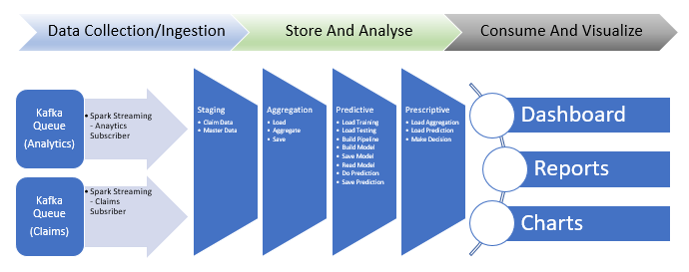
Analytics Dataflow Architecture

Slide 4
Analytics Use cases
Business Value
Analytics
Cost And Utilization
Quality Measures
Provider Performance
Episode Analytics
Population Health
Care Management
Prescriptive
Predictive
Graph
Descriptive

Slide 5
Algorithms Used
Descriptive
Aggregation
Predictive
Linear Regression
Graph
PageRank
Prescriptive
Combined
Logistic Regressoin
Connected components
Triangle count

Slide 6
Roadmap - Technical
Incorporate Apache NiFi, Apache Drill, Apache Kudu
Redis distribute cache implementation
Testing in multi cloud support
UI page to submit data and do online prediction
RuleIT Predictive Composer and authoring tools
HL7/EHR and Tensor flow/Deeplearning4java for clinical analytics.

Slide 7
Roadmap - Business
CMS identified 21 acute/chronic diseases which is high cost in inpatient claims which needs to be addressed in analytics to reduce the cost.
Fraud and abuse using graph analytics.
Promote value based care.
Support state/federal programs to predict capitation amount.
Potentially Preventable Readmissions.(Already implemented for COPD)
Facility Fee Reduction

Slide 8
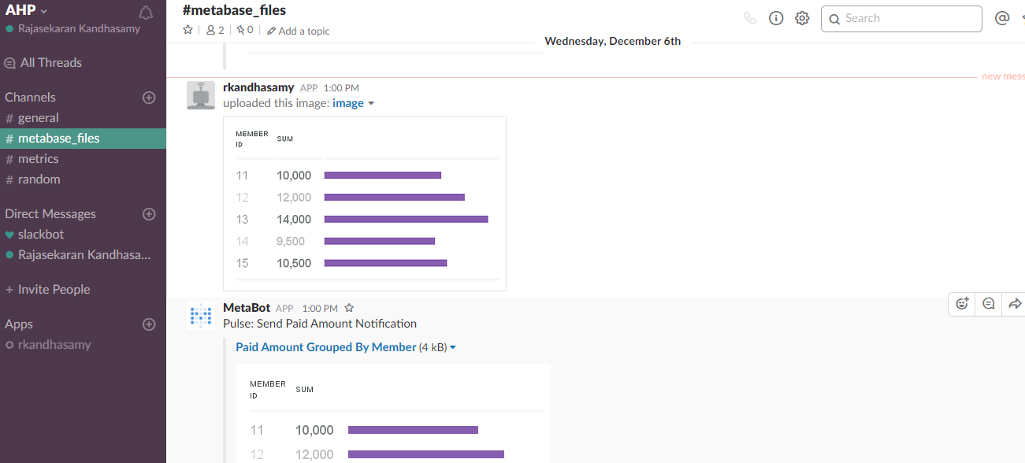
Slack Integration

Slide 9
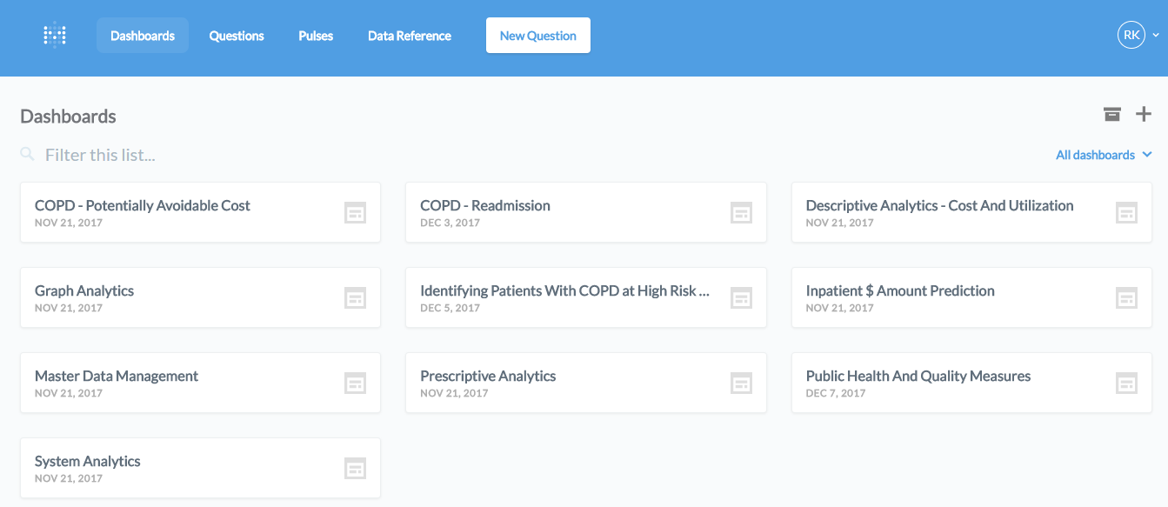

Slide 10
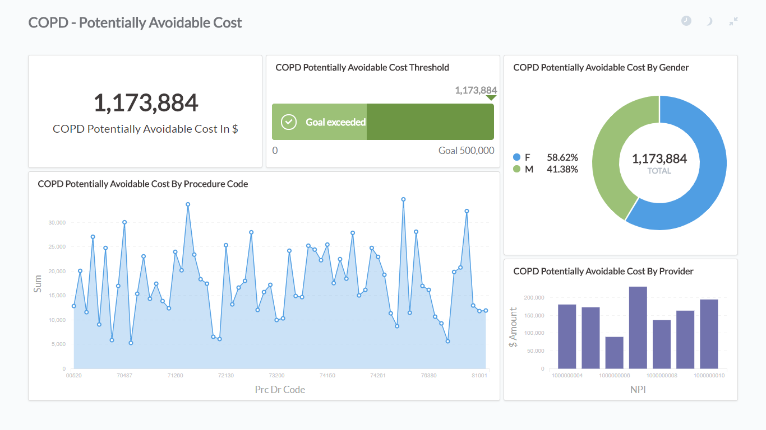

Slide 11
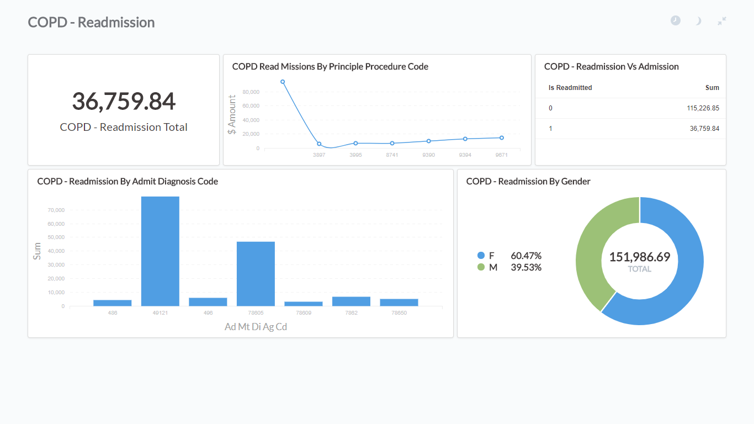

Slide 12
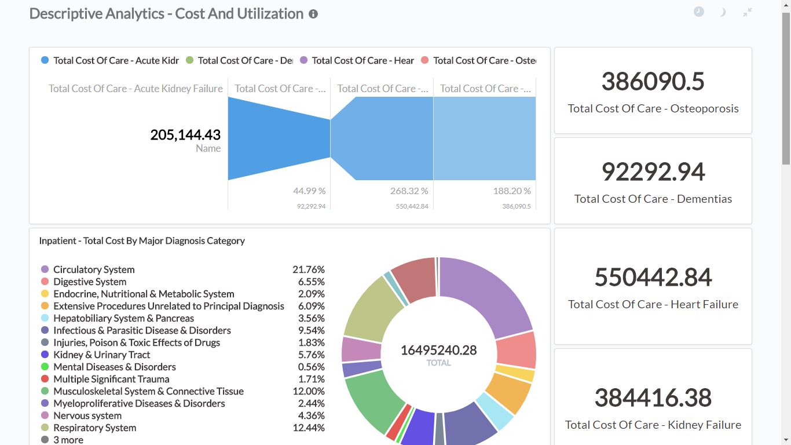

Slide 13
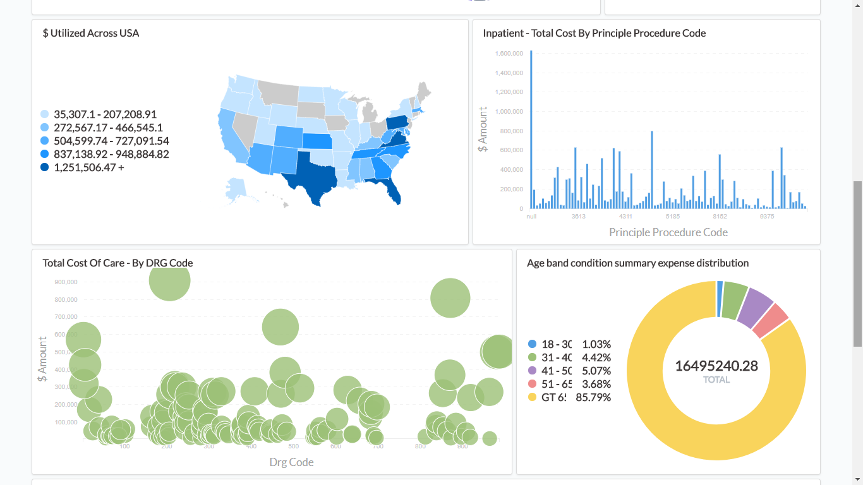

Slide 14
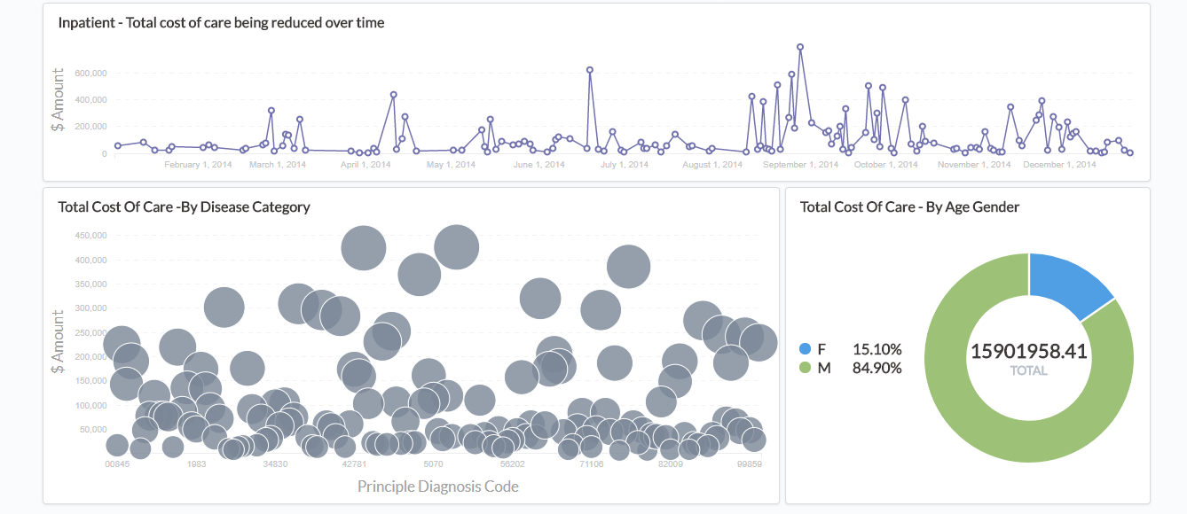

Slide 15
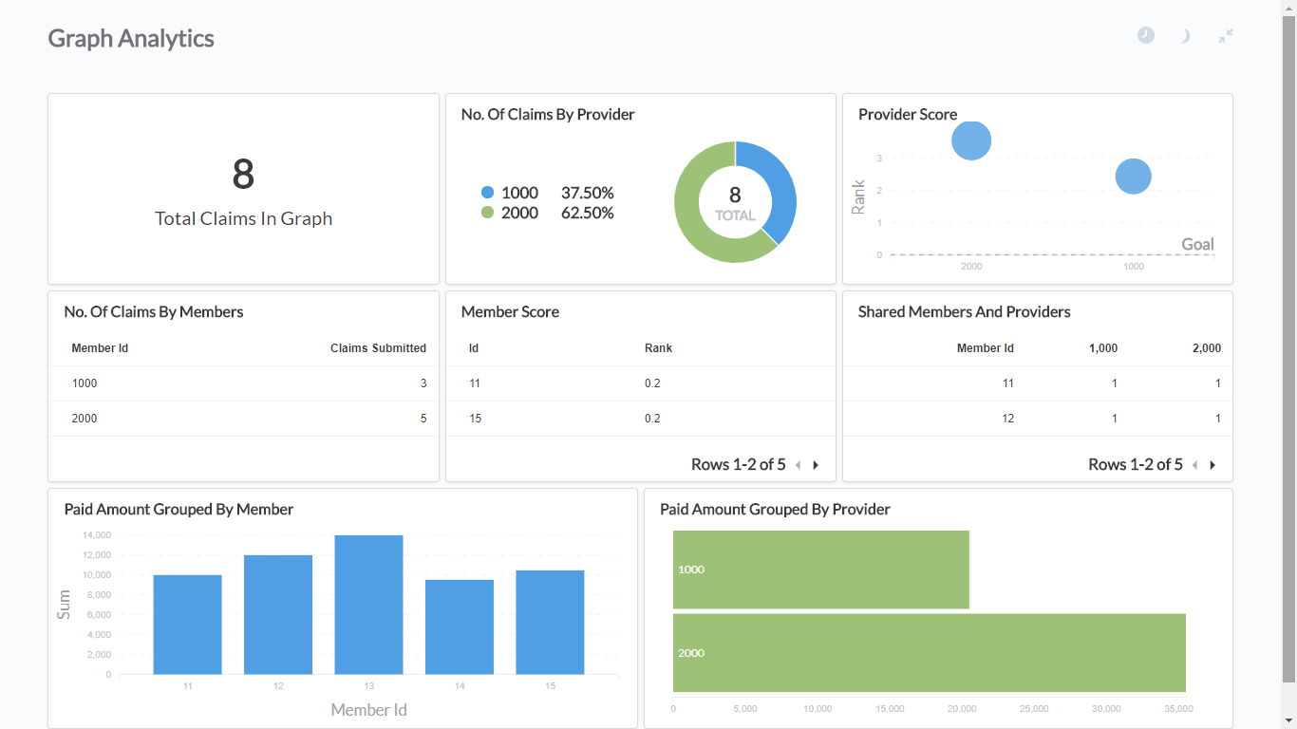

Slide 16
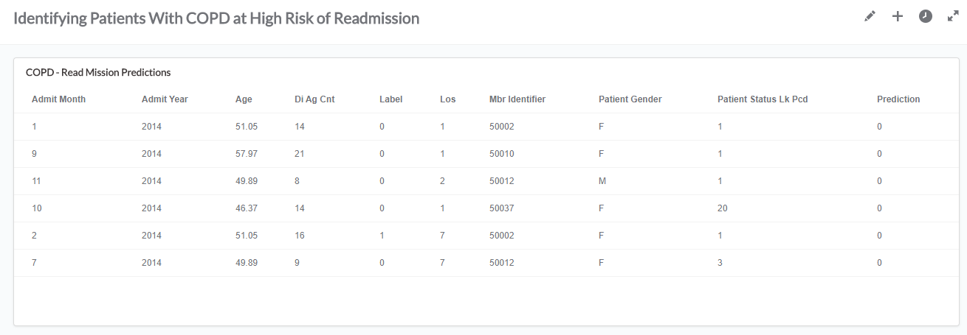

Slide 17
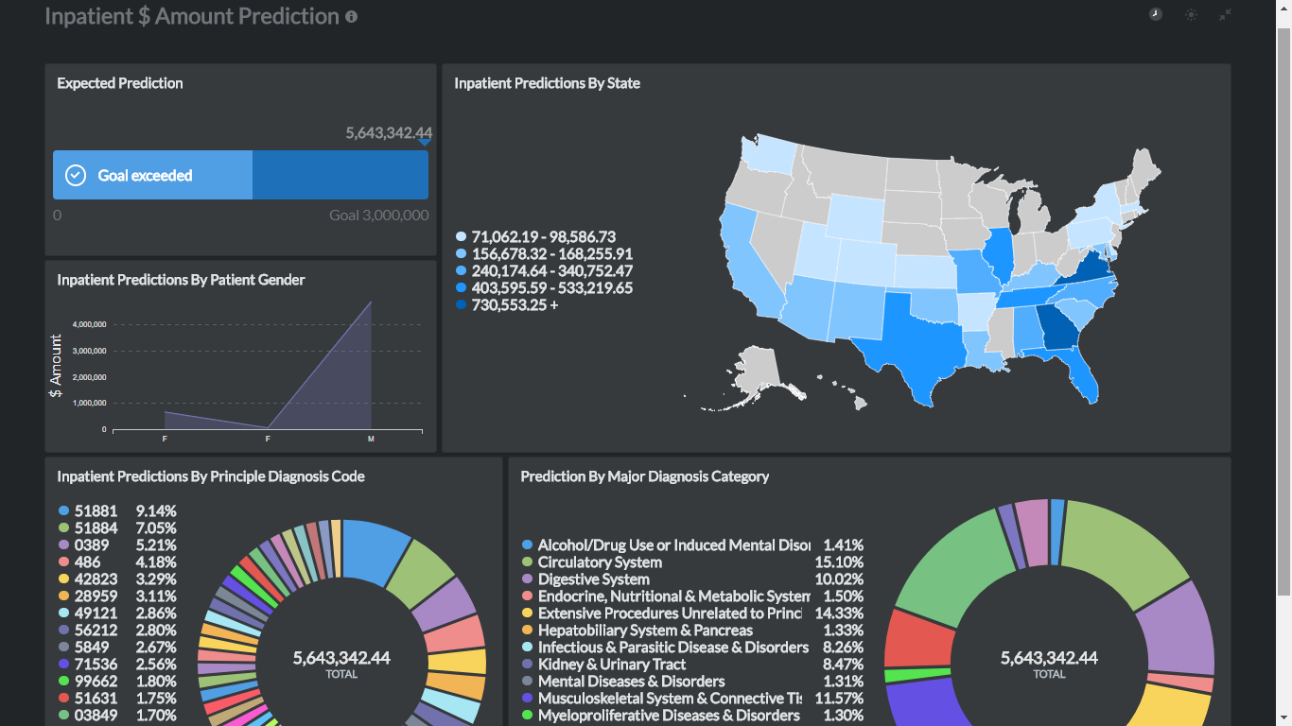

Slide 18
